Slide 1
mission: SURVIVE
Xaq Atkins, Toma Madansky, Radislav Nedelchev, William Collier, Andreea Buzatu, Kane Harper

Slide 2
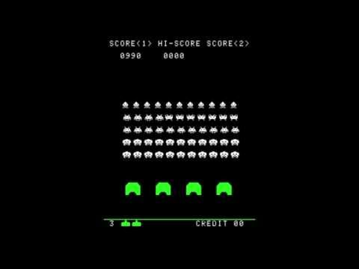
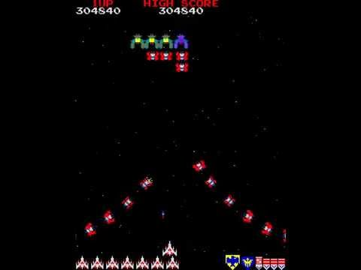
The project
The game that we have created is an implementation and an interesting mixture of a couple of arcade games such as Space Invaders, Asteroids and last but not least Galaga.
Except the implementation, we have created a story behind the game to allow the player to fully immerse himself in the game and created some really cool sound effects to to enhance the sense of adventure
Notes:
The project we all did is a game that implements the 1978 arcade game - Space Invaders. In our game, in addition to trying to maximize Space Invaders, we have also added some additional touches, such as a story, to a game that we hope will help the player delve deeper into it and experience something different. experience by trying to fit into the shoes of our main character. It is about the fact that our so-called rescuers, Dan and Rob, are on a deadly mission that is to destroy the many waves of aliens in space with their ship. They are trying to save the Earth from the invasion of aliens and go home unharmed.

Slide 3

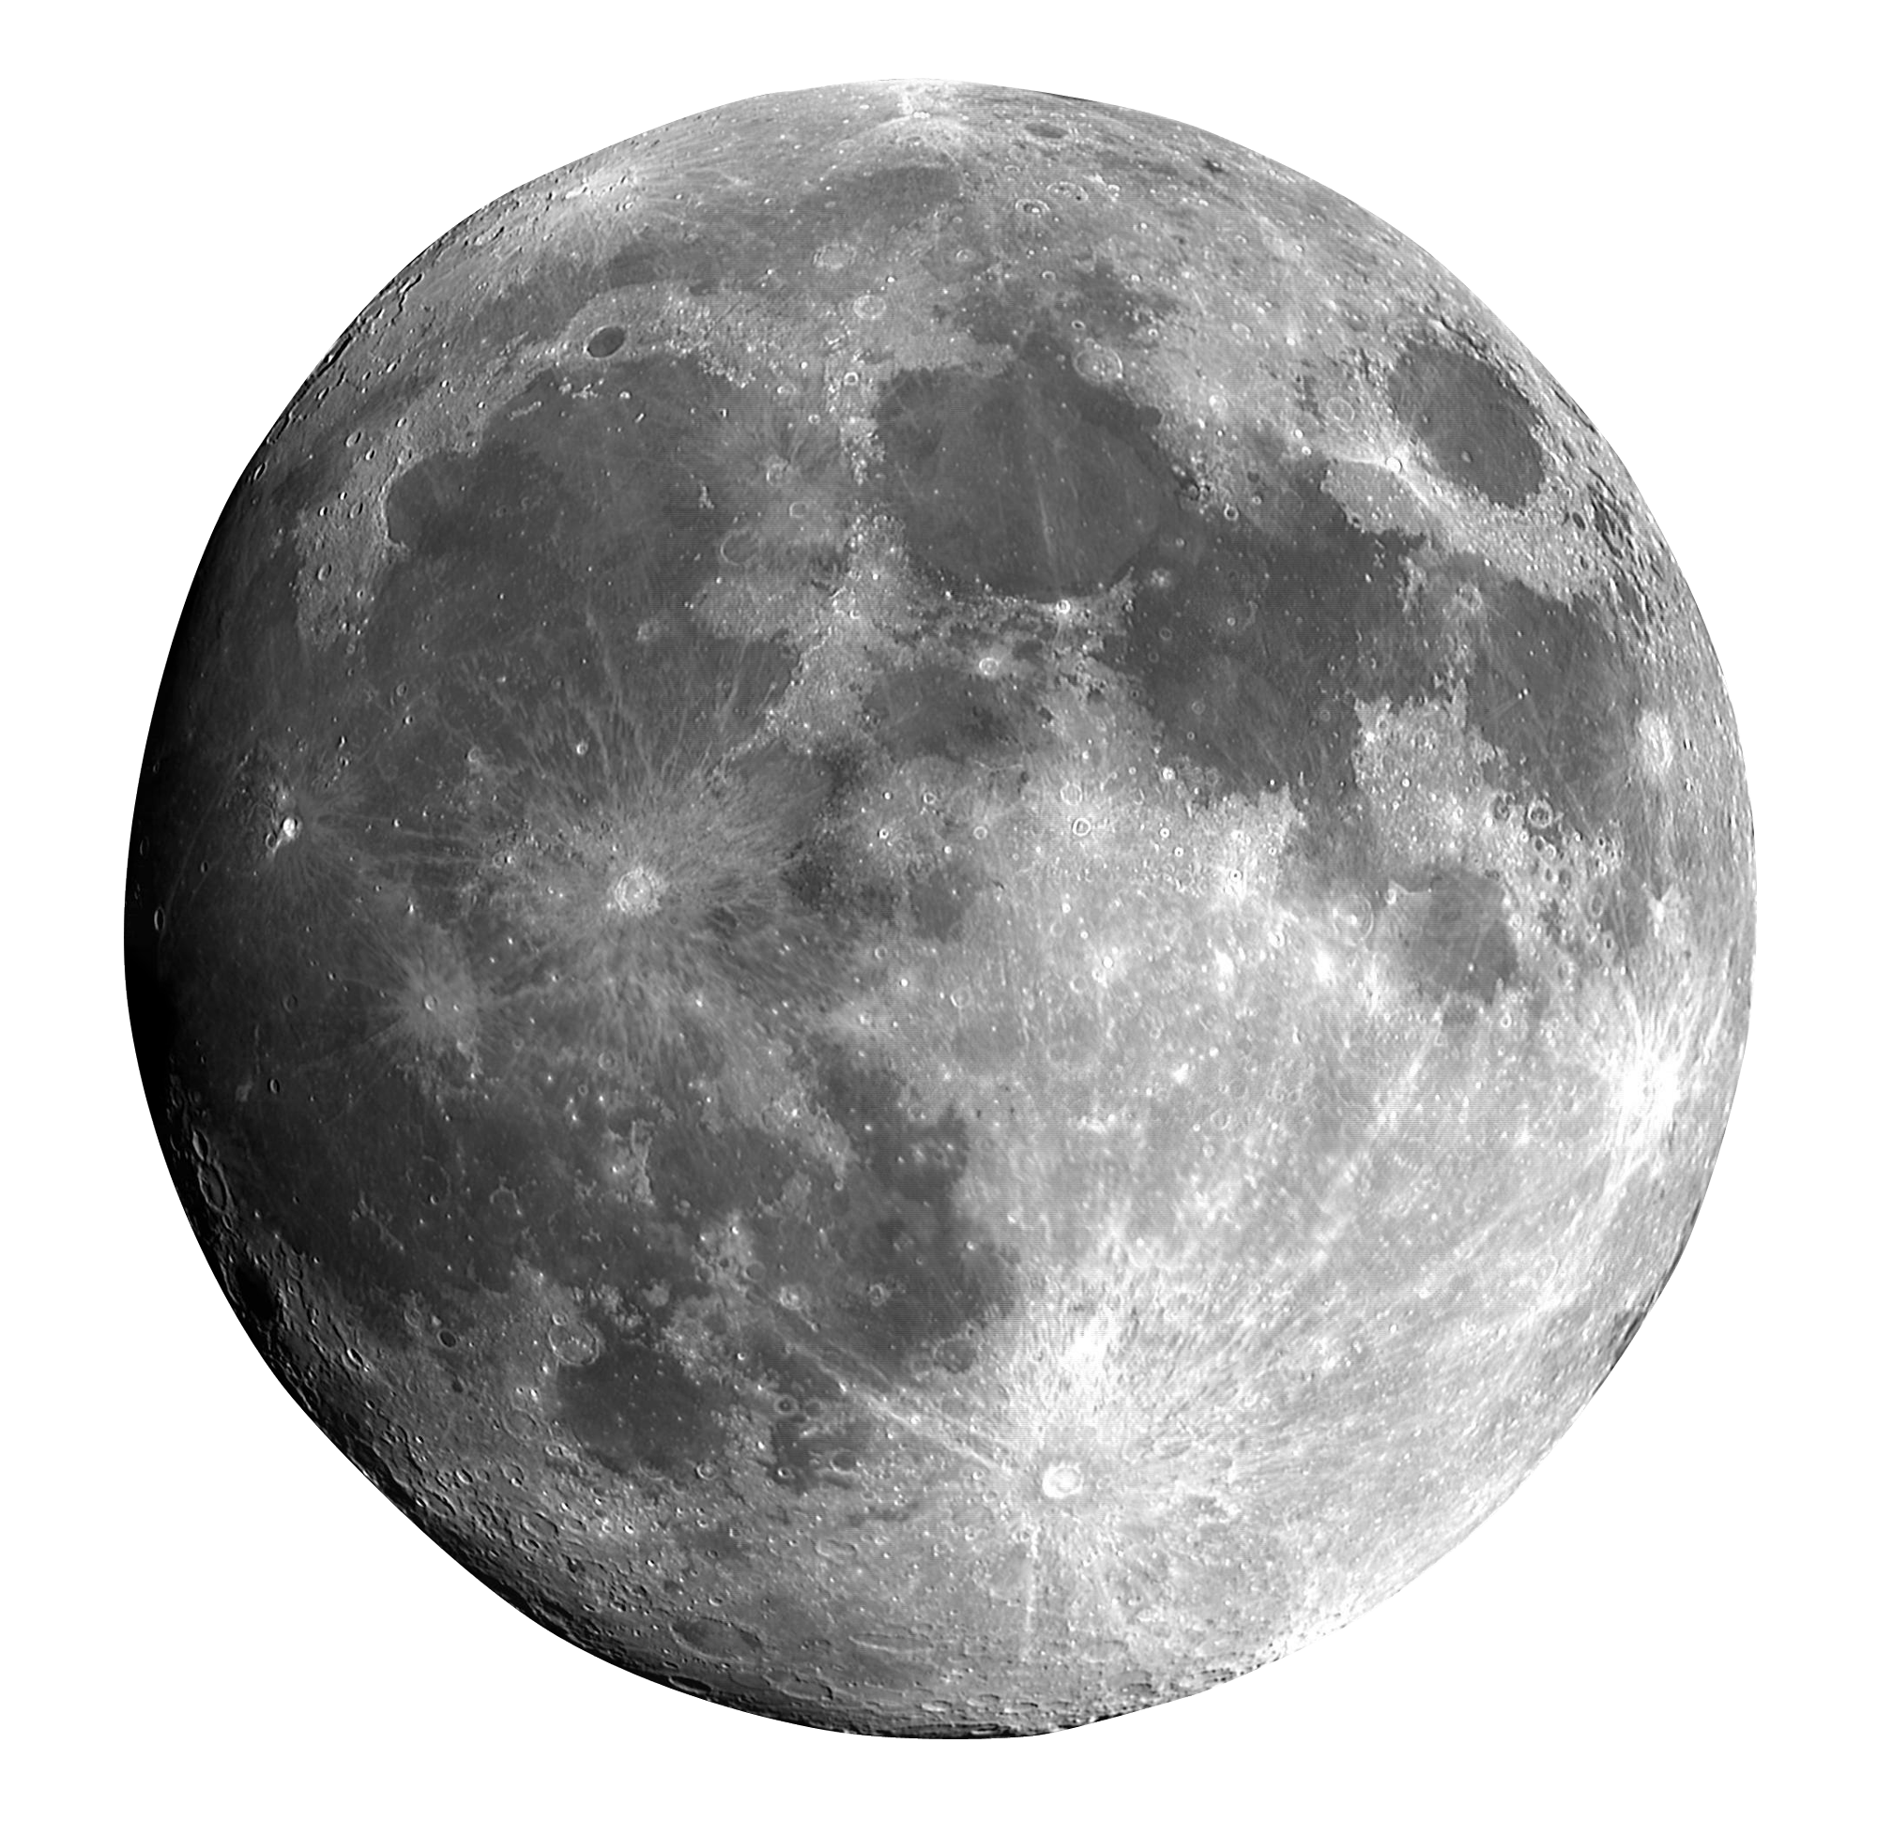


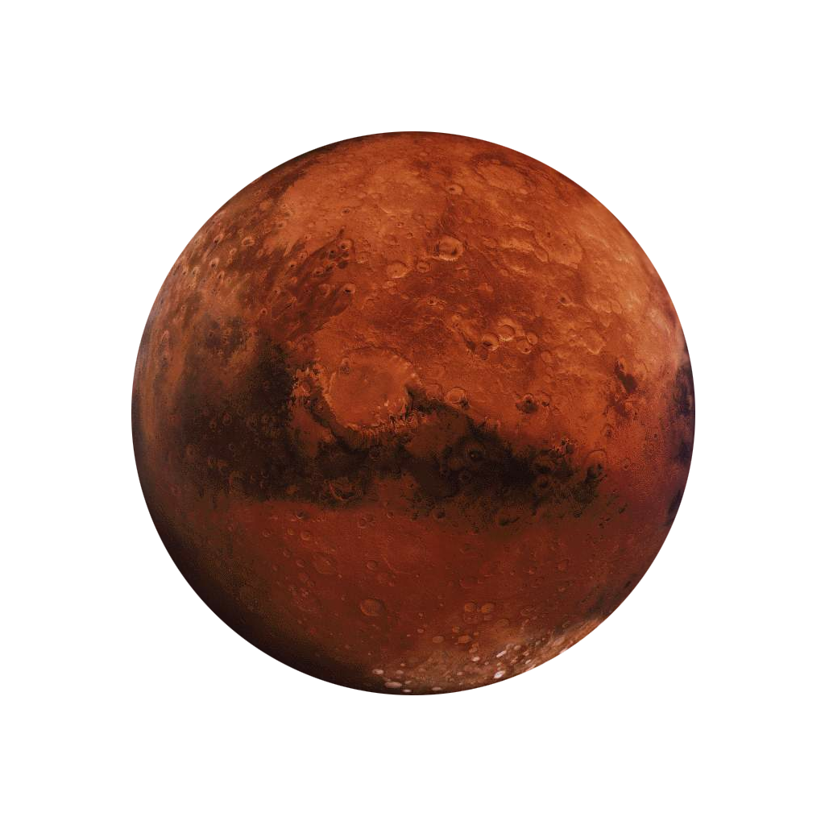
The Game
Everything takes place in 2043 when the humans run out of drinkable water and found a special liquid on Mars that can turn saltwater into drinkable one.
In the name of humanity, humans have begun to export that liquid rapidly in order to save the population
Notes:
- The situation with fighting the aliens are happening nowadays.
- The main problem is the lack of drinkable water on the planet Earth.
2.
Daniel (Dan) Wagner
Robert (Rob) Hughes
3.
The aliens are from the planet Kepler.
- Pre-history of the probelm:
For the past decade the lack of drinkable water has increased drastically and
humans have started to look for alternatives to survive.
(*During that decade the spaceshipping travelling was improved and it became not
that much hard to be accomplished* not necessary). Because the main goal was to survive,
all of the nations joined forces in that vital goal. Because Mars is one of the planets
that is most like Earth, the humans from the Earth started to send the most clever
scienities that are from all around the world to explore Mars and to do their
researchs and experiments. During one of the research processes the scientist
Alicia Herrera from Spain had discovered a liquid that from one drop of it can
turn a huge amount of salt water into drinkable one. As soon as that was discovered and there werent
any side effects, people started to export that new for the human kind strange liquid that was named Voda.
After a couple of months of travelling and exporting with big amounts that special
liqud it turned out that we were not alone in our universe actually. During one
of the many visits to Mars to export the liquid people had met aliens that want that
liquid as well and that's when the war started. Because the humans had transported
almost the whole amount of that liqud the aliens decided to invade the Earth and
take it from us.

Slide 4
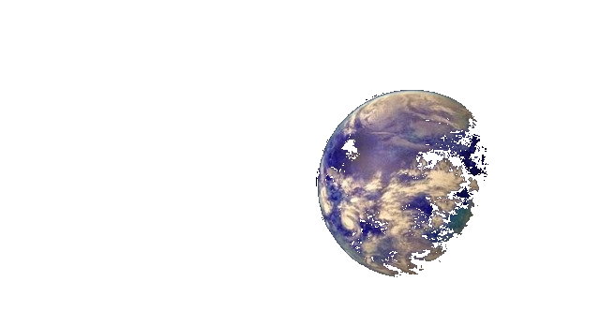




The Game
By this discovery came another one which is that we are not alone in our universe and that the aliens from the planet Kepler want that newly discovered liquid as well.
Because humans has already exported a really big amount of that liquid and did not want to cooperate with the aliens they have decided that they will take it the hard way.
Notes:
- The situation with fighting the aliens are happening nowadays.
- The main problem is the lack of drinkable water on the planet Earth.
2.
Daniel (Dan) Wagner
Robert (Rob) Hughes
3.
The aliens are from the planet Kepler.
- Pre-history of the probelm:
For the past decade the lack of drinkable water has increased drastically and
humans have started to look for alternatives to survive.
(*During that decade the spaceshipping travelling was improved and it became not
that much hard to be accomplished* not necessary). Because the main goal was to survive,
all of the nations joined forces in that vital goal. Because Mars is one of the planets
that is most like Earth, the humans from the Earth started to send the most clever
scienities that are from all around the world to explore Mars and to do their
researchs and experiments. During one of the research processes the scientist
Alicia Herrera from Spain had discovered a liquid that from one drop of it can
turn a huge amount of salt water into drinkable one. As soon as that was discovered and there werent
any side effects, people started to export that new for the human kind strange liquid that was named Voda.
After a couple of months of travelling and exporting with big amounts that special
liqud it turned out that we were not alone in our universe actually. During one
of the many visits to Mars to export the liquid people had met aliens that want that
liquid as well and that's when the war started. Because the humans had transported
almost the whole amount of that liqud the aliens decided to invade the Earth and
take it from us.

Slide 5
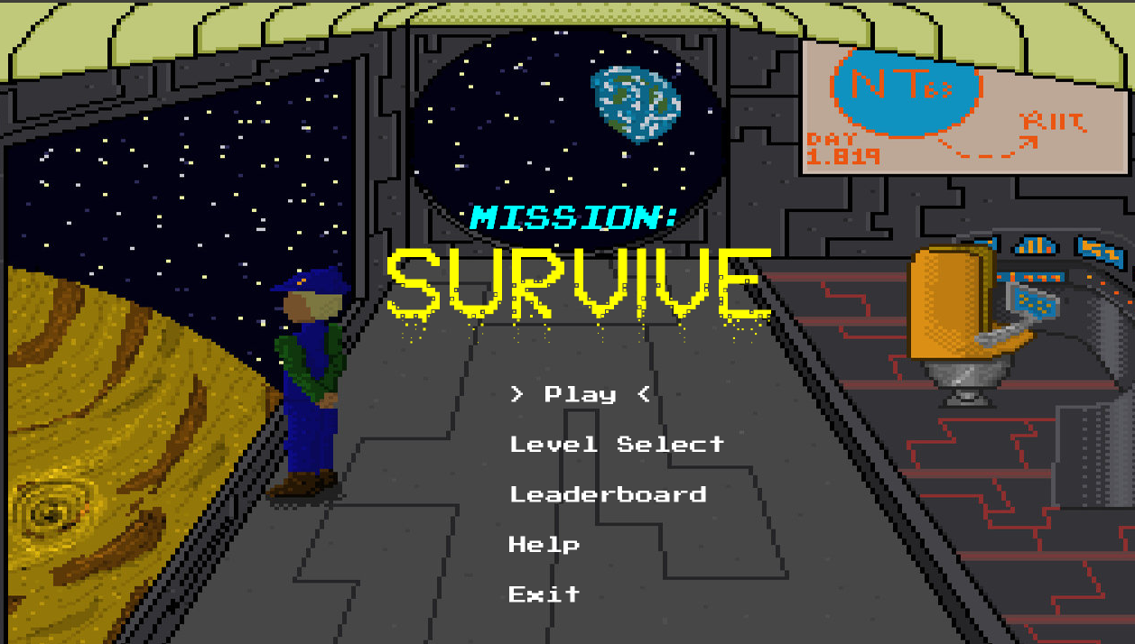
Gameplay - Menu

Slide 6
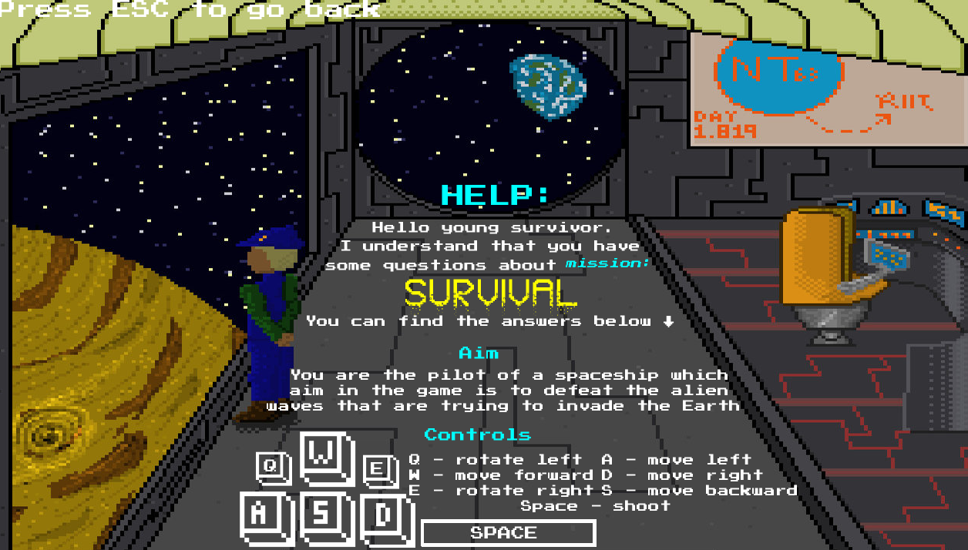
Gameplay - Help page

Slide 7
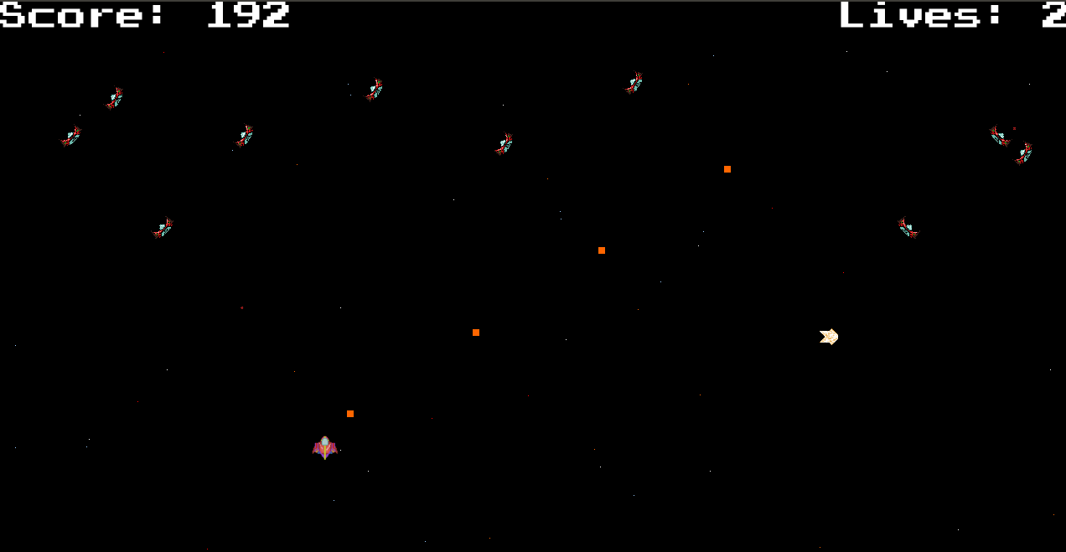
Gameplay - Level 2

Slide 8
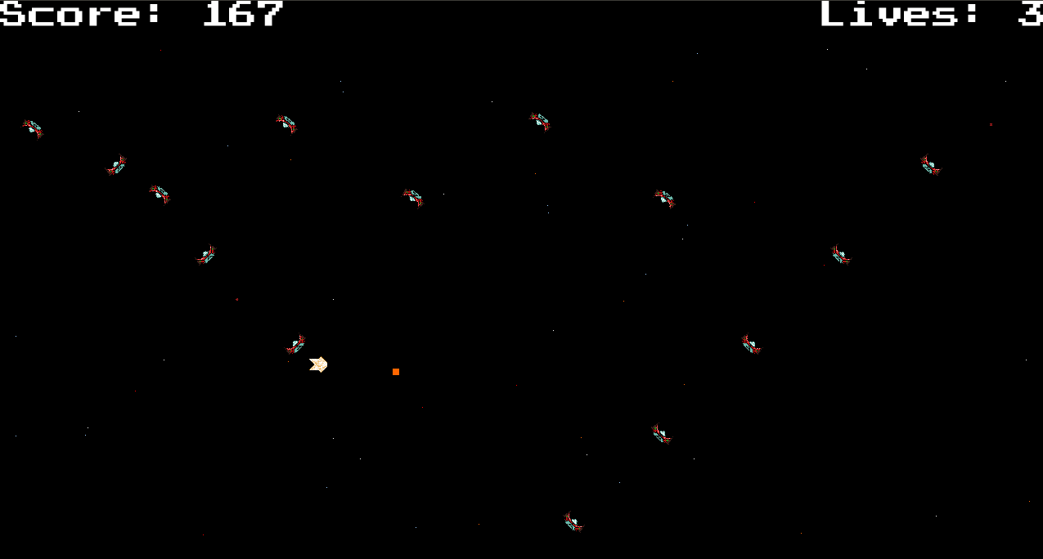
Gameplay - Level 3

Slide 9
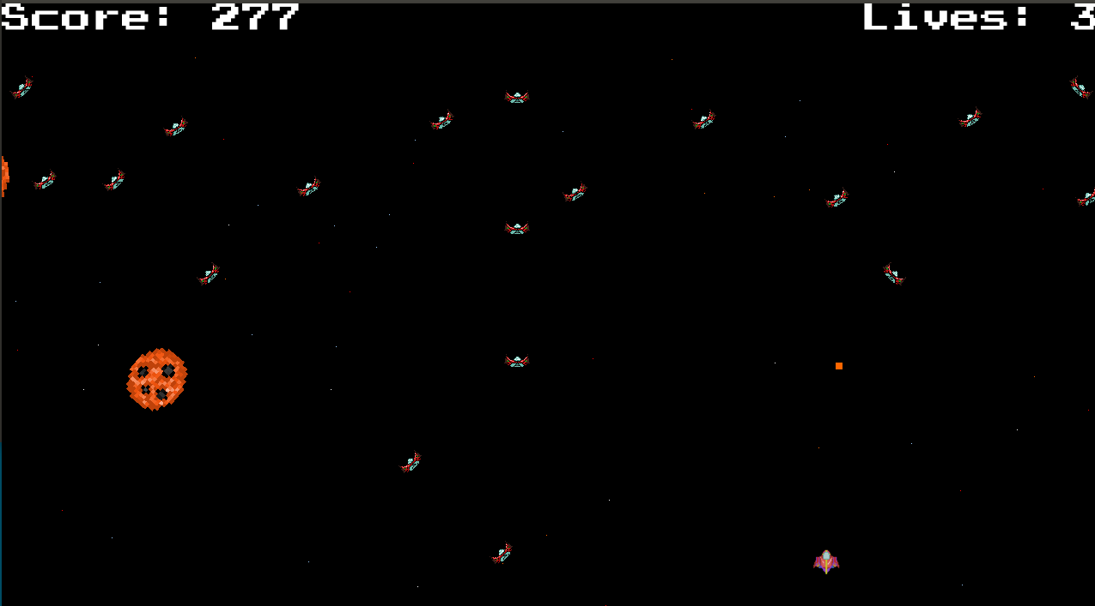
Gameplay - Level 4

Slide 10
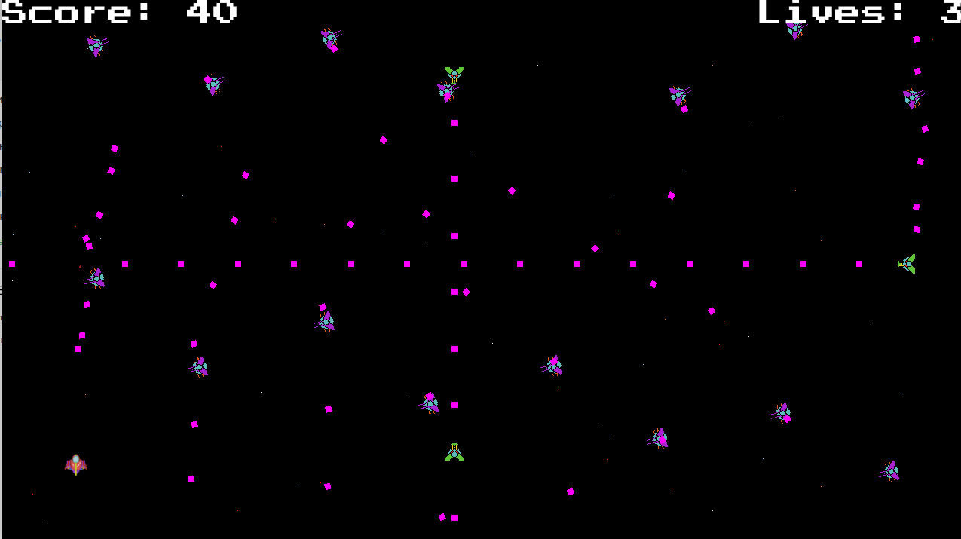
Gameplay - Level 5

Slide 11
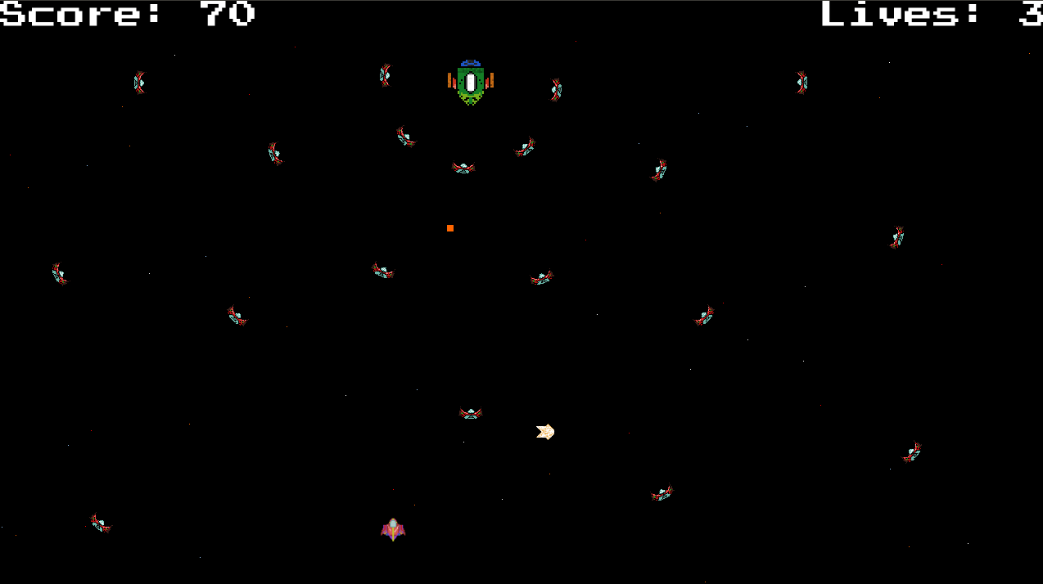
Gameplay - Final Boss level

Slide 12

Gameplay

Slide 13
Game rules
• The player can move their spaceship horizontally and vertically across the screen.
• The player can fire bullets from their spaceship cannons in order to destroy the aliens.
• The player has lives that if he loses all of them the game will end.
• The player can collect different power-ups after killing an enemy that can improve the speed of their bullets as well as increase the spaceship flying speed or increase its health.
• The game maintains a scoreboard of the highest scores achieved by players.

Slide 14
Key implementation challenges
• An important implementation challenge was related to the non-gameplay which is the engine creation. For example the resource loading and XML deserialzing.
• Java has limited memory management. We had to fight the Garbage Collector quite a good amount.
• Another challenge was that we were limited to the JSFML docs because forums were not always relevant and that is because JSFML was out of date with SFML.
• It was a lot of work in many different aspects because we could not use any third party dependencies.

Slide 15
Description of implementation process
The implementation process of the game was planned in the design report and it was followed strictly throughout the game development.
• The first task was to create the initial engine.
• The implementation of the gameplay was the second big task to be accomplished.
• The last process was to add content to the game.

Slide 16
User testing
• In the user testing 10 people took part and all of them played the game. Before the actual playing a consent form was filled out by them.
• During the process the testers had the opportunity to explore the main menu and to inform themselves beforehand from the help page about the aim of the game as well as the controls.
• After playing the game all of the participants gave two types of feedback. The first one was verbal feedback while the second one was an online form about their satisfaction experience throughout the game playing.

Slide 17
Evaluation process and results
The evaluation process from the user testing was vital to our game development because the participants gave us a great feedback about what could be improved so that the game could become more enjoyable and fun.
• For example one of our biggest problems was the fast spawning of power-ups which we fixed after more than 2 people mentioned that.
• Another great example was the too slow shooting rate of the lasers from the ship. This made us notice that this annoys people in some way so we increased it and become fast as possible to be still challenging and interesting to play.

Slide 18
Reflective evaluation of project
Worked on many ideas
Didn’t have time to implement all the initial ideas
We were too ambitious

